Slide 1
A Presentation By
Prof. D. Ilangovan, Dept. Of Commerce
Annamalai University, Annamalainagar – 608 002
Email: dil2691@yahoo.co.in Mob: 9443738926
Welcome All
EMOTIONAL INTELLIGENCE

Slide 2
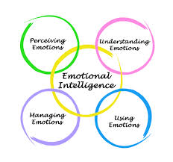
Dimensions of emotional intelligence

Slide 3

What is wisdom?

Slide 4
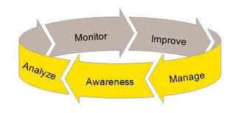
The way to understand one’s own self

Slide 5
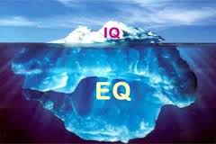

Slide 6
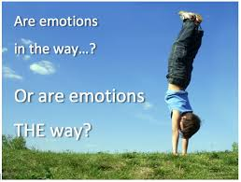
What is your way ?

Slide 7
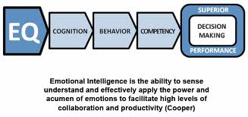

Slide 8
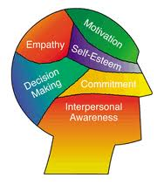
Emotions have direct bearing up on …..
EQ embraces two aspects of intelligence:
Understanding yourself, your goals, intentions, responses, behaviour and all.
Understanding others, and their feelings.

Slide 9
You got it !!!
Emotional intelligence (EQ) is the ability to identify, use, understand, and manage emotions in positive ways to relieve stress, communicate effectively, empathize with others, overcome challenges, and defuse conflict.
Emotional intelligence impacts many different aspects of your daily life, such as the way you behave and the way you interact with others.
If you have high emotional intelligence you are able to recognize your own emotional state and the emotional states of others, and engage with people in a way that draws them to you.
You can use this understanding of emotions to relate better to other people, form healthier relationships, achieve greater success at work, and lead a more fulfilling life.

Slide 10

The goal is ‘solution’ of some kind

Slide 11
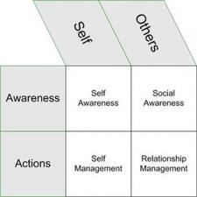
relationship management is the aim

Slide 12
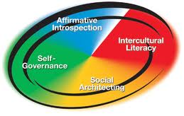
How do you construct your personality ?

Slide 13
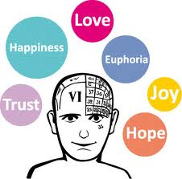

Slide 14
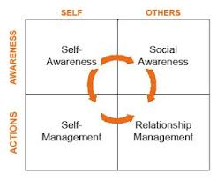

Slide 15
The skills required for successful E I
Emotional intelligence (EQ) consists of five key skills, each building on the last:
The ability to quickly reduce stress
The ability to recognize and manage your emotions
The ability to connect with others using nonverbal communication
The ability to use humor and play to deal with challenges
The ability to resolve conflicts positively and with confidence

Slide 16
Stress busting
Realize when you’re stressed – The first step to reducing stress is recognizing what stress feels like. How does your body feel when you’re stressed? Are your muscles or stomach tight or sore? Are your hands clenched? Is your breath shallow? Being aware of your physical response to stress will help regulate tension when it occurs.
Identify your stress response – Everyone reacts differently to stress. If you tend to become angry or agitated under stress, you will respond best to stress-relieving activities that quiet you down. If you tend to become depressed or withdrawn, you will respond best to stress-relieving activities that are stimulating. If you tend to freeze—speeding up in some ways while slowing down in others—you need stress-relieving activities that provide both comfort and stimulation.
Discover the stress-busting techniques that work for you – The best way to reduce stress quickly is by engaging one or more of your senses: sight, sound, smell, taste, and touch. Each person responds differently to sensory input, so you need to find things that are soothing and/or energizing to you. For example, if you’re a visual person you can relieve stress by surrounding yourself with uplifting images. If you respond more to sound, you may find a wind chime, a favorite piece of music, or the sound of a water fountain helps to quickly reduce your stress levels.

Slide 17
Be aware of your emotions
Do you experience feelings that flow, encountering one emotion after another as your experiences change from moment to moment?
Are your emotions accompanied by physical sensations that you experience in places like your stomach or chest?
Do you experience discrete feelings and emotions, such as anger, sadness, fear, joy, each of which is evident in subtle facial expressions?
Can you experience intense feelings that are strong enough to capture both your attention and that of others?
Do you pay attention to your emotions? Do they factor into your decision making?

Slide 18
Non-verbal communication
Focus on the other person. If you are planning what you’re going to say next, daydreaming, or thinking about something else, you are almost certain to miss nonverbal cues and other subtleties in the conversation.
Make eye contact. Eye contact can communicate interest, maintain the flow of a conversation, and help gauge the other person’s response.
Pay attention to nonverbal cues you’re sending and receiving, such as facial expression, tone of voice, posture and gestures, touch, and the timing and pace of the conversation

Slide 19
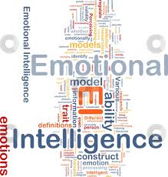

Slide 20
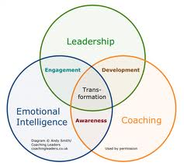

Slide 21
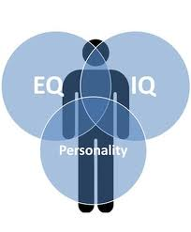

Slide 22
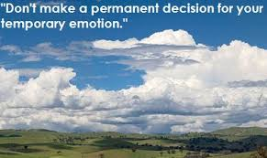

Slide 23
ultimate effect of emotional intelligence
Your performance at work. Emotional intelligence can help you navigate the social complexities of the workplace, lead and motivate others, and excel in your career. In fact, when it comes to gauging job candidates, many companies now view emotional intelligence as being as important as technical ability and require EQ testing before hiring.
Your physical health. If you’re unable to manage your stress levels, it can lead to serious health problems. Uncontrolled stress can raise blood pressure, suppress the immune system, increase the risk of heart attack and stroke, contribute to infertility, and speed up the aging process. The first step to improving emotional intelligence is to learn how to relieve stress.
Your mental health. Uncontrolled stress can also impact your mental health, making you vulnerable to anxiety and depression. If you are unable to understand and manage your emotions, you’ll also be open to mood swings, while an inability to form strong relationships can leave you feeling lonely and isolated.
Your relationships. By understanding your emotions and how to control them, you’re better able to express how you feel and understand how others are feeling. This allows you to communicate more effectively and forge stronger relationships, both at work and in your personal life.

Slide 24

THANK YOU mr.GOLeMAN FOR YOUR CONTRIBUTION
THANK YOU ALL

